Slide 1
An Introduction to GIT
An introduction to GIT that attempts to answer why the tool behaves the way it does.

Slide 2
What I am going to cover
A Git Repository
How is GIT different?
Which version is the latest?
Structure of a GIT repository
The Basics
The Tools
Init/Clone
Add/Check-in/Check-out
Push/Pull
Rolling back
Where are my changes?
Branching & Tagging
What is a GIT branch?
Where is my branch?
What good are tags anyway?
The Merge
How to deal with conflicts?
Cherry-picking
How to manage a large application with GIT
Subtree
Submodule
Anything
GIT and TFS
How to operate on a native TFS repository with GIT?

Slide 3
A GIT Repository

Slide 4
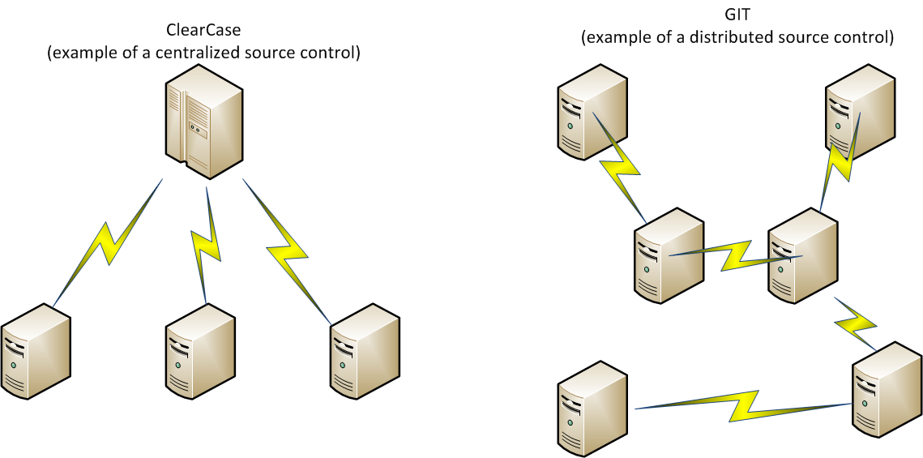
A GIT Repository
GIT is a distributed source control created for projects to coordinate changes by massive number of developers scattered all over the world.
Notes:
ClearCase is built for the enterprise: it is there to make sure you follow the rules of the enterprise. It assumes certain workflow and then tries to impose it on you: follow the process, or else. This is why it is so successful for waterfall development.
GIT, on the other hand, is built for loosely-organized teams of developers working on a single piece of code. It does not impose constraints on how these developers work as there isn’t a single rulebook everyone must obey. It is there to enable you to do anything you may need to do, up until you try to merge your code. This is where most of the governance happens. This is very appropriate for open source projects, where there is often no single person “in charge” and developers are very loosely organized and scattered all over the world.

Slide 5
A GIT Repository
Clients may not all be talking to the same “master”, but they have to agree on something:
That they are working on the same repository
The history of their repository up to their last merge point
In practice everyone agrees on a certain remote repository (e.g. GitHub) being the “master” and work both independently and as a group towards a project milestone, at which point they merge their changes into the master. What’s special about the master? Nothing. Nothing at all.
Notes:
GIT imposes no constraints on how developers work. There is no “preferred workflow” everyone should follow. Developers can synchronize their code developer-to-developer directly, or even create a “feature master”, which then gets merged into “code master”. The merge operation is the gatekeeper: at that point conflicts and other merge issues are identified and are being resolved. Some open-source projects introduce a full-blown code review process at this time!
The downside? With great power comes great responsibility.
Does this sound like Scrum agile to anyone?

Slide 6
A GIT Repository
How GIT stores things:
GIT organizes its repository in changesets that span the entire repository. A change set stores the deltas over the previous changeset: what was changed, added, removed repository-wide. Every participant agrees on the changesets and their order of the entire repository up to their last merge point. This is important.
This is *different* from what ClearCase does, where this concept does not exist. Instead, ClearCase keeps independent history for every file and then needs to take time to “assemble” a view on a given branch for you.
Repository
|
|
| +dir 2
Changeset 3
Repository
| *dir 1
\ +file 1
Changeset 2
Repository
| +dir 1
Changeset 1
Notes:
Think about changesets as transparencies stacked on top of each other, each containing some detail of a picture you are creating. Depending on how many transparencies you have stacked on top of each other and in what order, you see your final picture in varying state of completion.
How does this manifest? Why is this important?
Suppose we work on the same view in ClearCase:
You change a file.
I change a different file.
You check in.
I check in. ClearCase is happy to oblige as our changes are not in conflict.
Suppose we do the same in GIT: remember, GIT keeps history on repository level.
You check in. Everything’s fine.
I check in. Everything’s still fine.
You sync with remote. No problems.
I sync with remote. GIT gives me an error. Something cryptic about fast-forward.
The conflict here isn’t our changes being incompatible, but which changeset comes first in the repository. Remember, changesets are repository-wide deltas. GIT repositories not only have to agree on changesets, but also on their order. My changesets wants to go in at the very spot your changeset occupies in the master repository. To fix this, I have to merge your changeset into my repository, thus pushing your change before mine, and then attempt to sync again. Alternatively, I have to get rid of your changeset from master, pushing my change in the place of yours.
Needless to say a GIT repository with a very large code base stored inside would be very difficult to work with, something ClearCase has no trouble with.

Slide 7
A GIT Repository
What happens when I want to work on a remote repository? I clone it as a local repository.
Cloning a GIT repository copies the entire history of the repository, all changesets: all files that are, all the files that were, and every version of those files, into a local file-based database. It then assembles my view from those changesets.
This is different from how ClearCase works: ClearCase simply gives you the view of the repository today.
Repository
|
|
| +dir 2
Repository
|
|
| +dir 2
Repository
| *dir 1
\ +file 1
Clone
Repository
| *dir 1
\ +file 1
Repository
| +dir 1
Repository
| +dir 1
Notes:
When I work on a shared repository, I clone it for my own use. I copy the entire repository, everything that ever was in it, in every version. This is equivalent to me walking into the server room and cloning the ClearCase server’s hard drive. Needless to say GIT performs at its best when the individual repositories are kept very small.
** This is one reason you don’t want to have checked-in compiled artifacts in GIT. That file changes every time you build and the “deltas” often span the entire file. GIT then becomes very slow as a simple clone operation ends up downloading every verison of the file that ever was. Furthermore it does not recover even if I delete the checked-in artifact, since ultimately the file lives in the changesets that are already part of the history. I have to “squash” your changesets to fix this.
I can work offline! I can keep working while riding on the subway! Good luck doing that with ClearCase.

Slide 8
A GIT Repository
What about conflicts? What conflicts?
Repository
| dir 1
\ -file 1
Repository
| dir 1
\ *file 1
Conflicts can and do occur. GIT takes the optimistic approach: it lets them happen and then asks you to fix them.
This is different from ClearCase where conflicts do not occur as files are checked out reserved, or else your commit gets rejected.
Repository
|
|
| +dir 2
Repository
|
|
| +dir 2
Repository
| *dir 1
\ +file 1
Repository
| *dir 1
\ +file 1
Repository
| +dir 1
Repository
| +dir 1
Notes:
GIT, being distributed, cannot control who changes what in a real-time centralized fashion as ClearCase does. Conflicts can and do happen. To address them, GIT takes an “optimistic” approach: it lets you do anything you want, but if that runs into a problem when merging with a remote repository, it will ask you to manually merge conflicts it cannot resolve by itself.
ClearCase, in comparison, does a lot of its “policing” upfront: you can’t touch file “file 1” because someone else is editing it. Take your turn. GIT does its “policing” when merging with a remote repository, which is where all the problems usually happen. GIT will stay out of your way, letting you do whatever you want, until you try to merge.
This is how most open-source projects police their code as well: example CyanogenMod
https://github.com/CyanogenMod
http://review.cyanogenmod.org/#/q/status:open

Slide 9
Which Version Is The Latest?
Two GIT repositories have to agree on the following:
That they are in fact the same repository
All changesets up to their last merge point, as well as their order.
Repository
| dir 1
\ -file 1
Repository
| dir 1
\ *file 1
And here they have
Began to diverge.
Repository
|
|
| +dir 2
Repository
|
|
| +dir 2
Last merge point.
The two repositories
Are in agreement up
To this point.
Repository
| *dir 1
\ +file 1
Repository
| *dir 1
\ +file 1
Repository
| +dir 1
Repository
| +dir 1
Notes:
Two repositories are the same repository if they have identical changesets. Every changeset gets a GUID when it is created: a globally unique number that is highly unlikely to have ever been generated in the past, or to ever be generated again. If two repositories have changesets with identical GUIDs up to a certain point, they are the same repository. So which version is the latest? They both are! Until they synchronize again, these are two divergent repositories.
Typical GIT workflow:
Sync local repository with a remote repository
Make changes to it, causing it to diverge
Sync local repository with a remote repository again, fixing any problems
Repeat until done.

Slide 10
Structure of a GIT Repository
There are 3 parts to a GIT repository:
The local changeset database: this is where the changesets live. You can’t work here, your files are scattered all over the place.
Staging area: this is a preparation area where you “compose” a changeset you are currently working on. The staging area is private: it does not get synchronized with remote. If you ask GIT to reset, all changes here are lost forever.
Workspace: this is where GIT assembles a representation of your source code at a certain changeset. GIT will go out, figure out which changesets are needed and patch your files as needed to recreate the state of your code at that point in time.
Notes:
The changeset database is a locally-hosted database that makes an extensive use of hashing to index and store your changesets. This is the only part of your GIT repository that gets synchronized with a remote repository. The other parts belong to you and are private to you.
Staging area is where you tell GIT which modified/new/deleted files are to be part of the changeset. This is a manual step: changing a file does not automatically include it in your changeset, though there are tools to make this very fast and simple.
Workspace is where GIT recreates the state of your code after a certain changeset. What happens is, GIT figures out which changesets it needs, takes out the earliest one and applies it. Then takes the next one and “patches” your files on top. Then takes the next one after that and does the same… up until the state of your code is represented. You can instruct GIT to give you the latest state of your repository, or at some point in the past. GIT is a super-efficient delta management system with a DIFF engine added on top. Things happen so fast, if you come from ClearCase you may think something went wrong and GIT did nothing.
It is possible to have a GIT repository without a staging area or a workspace. This is often done for repositories not used for development (e.g. masters). Such a repository is there solely so that it can organize your changesets.

Slide 11
Structure of a GIT Repository
Changeset database
commit
Staging area
add
Workspace
checkout
Notes:
Some standard GIT terminology finally:
When I “checkout” at certain changeset (or HEAD), I ask GIT to parse the changesets all the way from the creation of the repository and give me the state of my code after the changeset I am checking out.
When I “add” a file I have modified, it becomes part of a changeset I am staging for commit. The changeset can change at this point: files can be added or removed. Only files that have been modified, created or deleted can be added to the staging area. If GIT refuses to add a file to the Staging area, that is usually why.
When I “commit”, everything in the staging area is being cast into a brand new changeset and it is added in the local changeset database. At this point the changeset GUID gets created. It is impossible to change a changeset once commited. With a few special-case exceptions a changeset can be deleted, thus rewriting the history of your repository, squashed with other changesets, but not modified. Everyone must agree on a changeset GUID representing a certain change, so changesets themselves can never be versioned.
And now one of the major differences with ClearCase: after all this, changes are still sitting on your computer. If your hard drive crashes, your changes will be gone.

Slide 12
Structure of a GIT Repository
Remote
changeset database
push
Changeset database
Staging area
pull
Workspace
These are the only two operations to synchronize a local with a remote repository. Until you call push or pull, you are only changing your local repository and no one but you can see your changes.
Notes:
You can’t change a remote repository directly. You always change your local repository first and then synchronize your changes by pushing and/or pulling. Always.
Pushing attempts to merge any additional changesets you have created to the remote repository. The remote repository will attempt to merge your changes, however if it contains changesets you do not have, it will ask you to pull first. Remember, your local repository has to agree on the entire history of the remote repository up to the last sync point.
Pulling attempts to bring in any changesets the remote repository has that have been pushed to it after you pulled last/cloned. These are changesets you do not have that other people have pushed. It is at this stage merge conflicts usually occur. GIT will do its best to merge changes, but may flag conflicts for you to manually merge in case there is a problem.
Some places such as GitHub allow you to do a sort of two-step pushing to a remote repository, which is often used by open-source projects for code reviews. In general, you clone a repository under your user at GitHub, you modify it by adding your changesets on top, and then send a “pull request” to the owners of the original repository. Your changes are made available for review, but are not part of their original repository yet. It is up to those reviewers to look through your changes and “pull” them into their repository if they are happy with them, hence the term “pull request”. This is where tools such as GERRIT come into play.
Scrum agile as implemented at TELUS often suffers from code quality problems and it is THIS type of process that would help fix that. Many teams have an informal code review process, but many do not. Also, it is often very VERY difficult to contribute code to components owned by other team: the silos are not yet fully broken.

Slide 13
The Basics

Slide 14
The Tools
BEWARE OF TOOLS THAT TRY TO DO THE THINKING FOR YOU!
Notes:
Lots of tools out there, most of which I find confusing and/or inadequate for all but the most trivial use.
A lot of the more “advanced” tools attempt to simplify things for you by trying to do some of the thinking for you. Problem with that is, GIT is very well thought-out and there is always a very good reason why GIT exposes the level of granularity it does: these “advanced” tools typically don’t have a clue what it is you are trying to accomplish and tend to get you in trouble sooner or later, leaving a horrible mess behind. Furthermore, they shield you from what is really going on behind the scenes, making it even harder to learn GIT.
The most successful tools for GIT that I have seen tend to be little more than thin wrappers around GIT itself, allowing you to interact with GIT faster and presenting a more usable interface to it, but otherwise presenting the same level of granularity. Doing anything tends to take several clicks of the mouse, but everything you see translates directly to a GIT operation you can easily wrap your head around.
The pure GIT is, of course, strictly command-line. There is a learning curve, but believe it or not you will learn GIT very fast if you choose to go this route.

Slide 15
The Tools
The tools I use:
GIT for Windows: https://git-scm.herokuapp.com/download/win
TortoiseGIT: https://code.google.com/p/tortoisegit/
eGIT: https://eclipse.org/egit/
GIT-TF: https://gittf.codeplex.com/
Other tools:
Atlassan SourceTree: http://blogs.atlassian.com/2013/03/introducing-sourcetree-git-client-microsoft-windows/
Notes:
GIT for Windows is exactly what it sounds like: a command-line GIT for Windows. I still have not found a better way to use GIT.
TortoiseGIT is the best GIT client for Windows. This is a very simple wrapper for GIT exposing a lot of the same operations at a click of a mouse. I wish there were a Mac/Linux version. Highly recommend.
eGIT is an Eclipse plugin, which integrates GIT right into Eclipse. I personally find it difficult to use, but always have it installed.
GIT-TF works with GIT for Windows to allow integration of native TFS repositories with GIT. It works surprisingly well!
Atlassan SourceTree is the best-looking and most advanced GIT client that I know of. It is loved by many people, but I personally find it more trouble than it is worth. Beware of bugs.

Slide 16
Init/Clone
Both of these create a repository for you to work on:
Init – creates a brand new GIT repository from scratch. Use when you do not intend to synchronize your repository anywhere else, or you wish to create a new master repository.
Clone – replicate a remote repository into a local repository in its entirety. The entire history of the repository gets copied over. The remote repository is set as an upstream repository so you can use push/pull to synchronize it.
Notes:
Demo it.

